Slide 1
AI-Powered Skill Gap Analyzer
Comparing Resume & Job Description to Identify Skill Gaps using NLP & SBERT
Presented by: Sakshi Dande

Slide 2
Introduction
The rapid growth of technology demands updated and competitive skills.
Many candidates struggle to understand how their resume aligns with job requirements.
Recruiters spend significant time manually reviewing resumes.
Problem: Difficult to identify skill gaps quickly & accurately.
Solution: An AI-based system that compares resume skills and job description skills to measure compatibility.

Slide 3
Problem Statement
Candidates are often unaware of which skills they lack for a target job role.
Manual comparison is time-consuming, biased, and inaccurate.
No simple automated platform currently provides quantified similarity score and upskilling recommendations.
Goal: Build a tool that automatically highlights matched, weak, and missing skills.

Slide 4
Objectives
Extract skills from resumes and job descriptions.
Identify similarity using Sentence-BERT vector embeddings.
Categorize skills into Matched / Weak Match / Missing.
Display results using a visual dashboard.
Allow users to download a skill gap report (CSV/XLSX).

Slide 5
Proposed System
Upload Resume & Job Description
Extract text from PDF/DOCX/TXT
Clean and preprocess text
Perform keyword & spaCy-based skill extraction
Generate vector embeddings using SBERT
Compare vectors using cosine similarity
Classify skill gap categories
Display analytics with graphs & tables
Export results as downloadable report

Slide 6
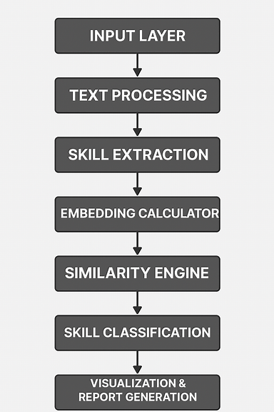
System Architecture Diagram

Slide 7
Technologies Used
Component | Tools / Libraries
Programming Language | Python
NLP | spaCy, SBERT, Sentence-Transformers
ML Similarity Model | all-MiniLM-L6-v2
Text Extraction | pdfminer, python-docx
Frontend UI | Streamlit
Visualization | Matplotlib, Plotly
Data Handling | Pandas
Export | CSV, Excel (openpyxl)

Slide 8
Workflow
Input Resume & JD through UI
File Parser extracts text
NLP skill extraction
SBERT embedding generation
Cosine similarity scoring
Gap classification
Visualization & report export

Slide 9
Results & Output
Overall skill match score (percentage)
Table displaying similarity score by skill
Visual charts:
  Pie chart for matched/weak/missing
  Bar chart for similarity comparison
Recommendations for upskilling
Report export available

Slide 10
Advantages
Saves recruiter screening time
Helps job seekers focus on necessary skill upgrades
Reduces human bias
Real-time automated evaluation
User-friendly UI with visual insights

Slide 11
Applications
Job seekers for interview preparation
HR & recruitment teams
EdTech & career guidance platforms
Resume enhancement services
Training institutes for curriculum planning

Slide 12
Future Enhancements
Integration of LLM for intelligent recommendations
Dashboard with multiple resume comparison
Support for multiple languages
Integration with job portals (LinkedIn, Naukri, Indeed)
Chatbot to guide learning roadmap

Slide 13
Conclusion
The system provides an automated and efficient approach to identify skill gaps.
Uses NLP & SBERT to compare resumes with job descriptions accurately.
Supports decision-making for career growth and hiring processes.

Slide 14
THANK YOU

